Slide 1
Anti-Retroviral Therapy Basics
E Duke

Slide 2
David Spach’s National HIV Curriculum
https://www.hiv.uw.edu/page/treatment/drugs

Slide 3
HIV Virion

Slide 4
HIV Virion
Integrase
ssRNA
Reverse Transcriptase

Slide 5
CD4 T Lymphocyte

Slide 6
HIV Infection
CCR5 co-receptor
HIV
CD4 receptor
Nucleus
Human CD4+ T cell

Slide 7
HIV Infection
CCR5 co-receptor
CD4 receptor
Nucleus
Human CD4+ T cell

Slide 8
HIV Infection
Nucleus
Human CD4+ T cell

Slide 9
HIV Infection
Nucleus
Human CD4+ T cell

Slide 10
HIV Infection
proviral dna
Reverse transcriptase (RT)
viral rna
Nucleus
Human CD4+ T cell

Slide 11
HIV Infection
proviral dna
viral rna
Nucleus
Human CD4+ T cell
https://www.genome.gov/26524120

Slide 12
proviral dna
Integrase
viral rna
Nucleus
Human CD4+ T cell
https://www.genome.gov/26524120

Slide 13
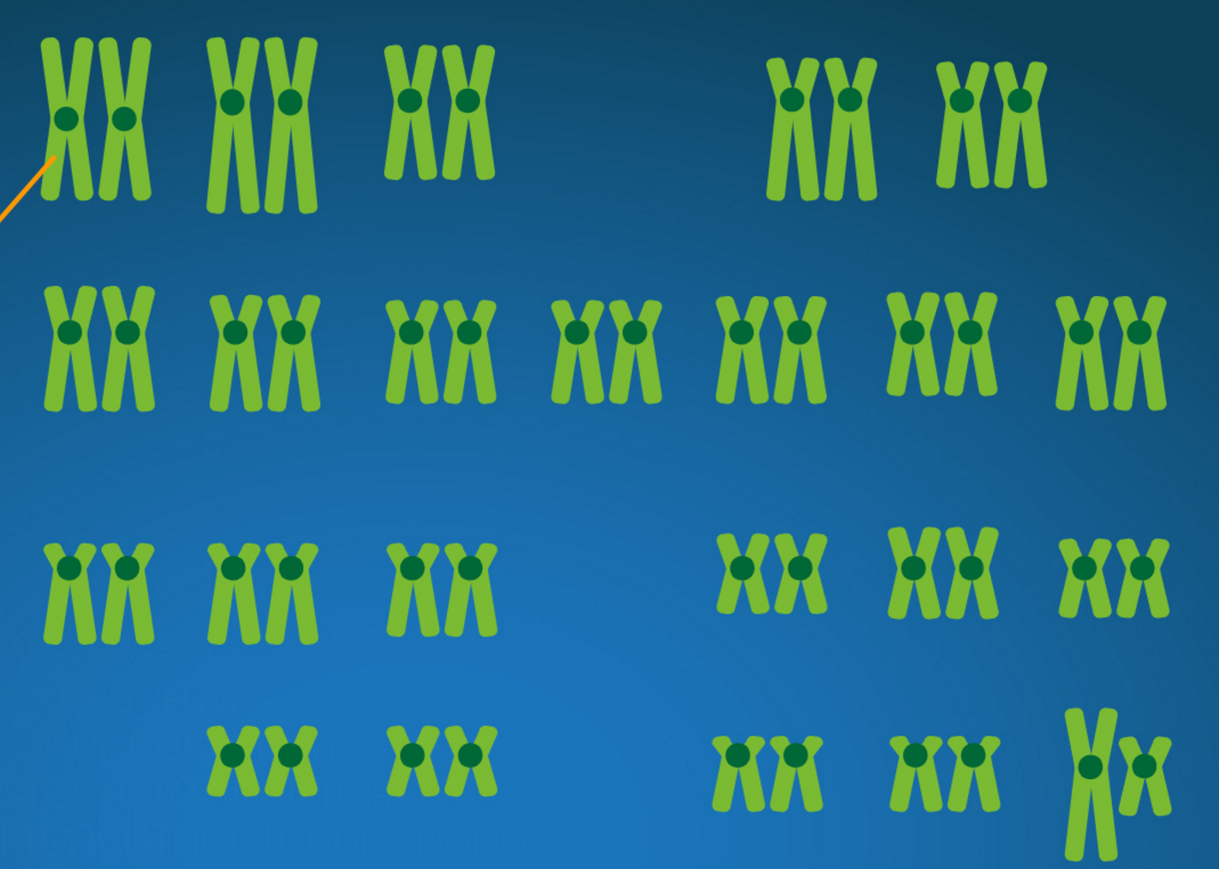
proviral dna
Integrase
46 chromosomes
viral rna
Nucleus
Human CD4+ T cell
https://www.genome.gov/26524120

Slide 14
HIV Infection
proviral dna
46 chromosomes
viral rna
Nucleus
Human CD4+ T cell
https://www.genome.gov/26524120

Slide 15
HIV Infection
proviral dna
46 chromosomes
viral rna
Nucleus
Human CD4+ T cell
https://www.genome.gov/26524120

Slide 16
HIV Replication/Maturation/
Budding

Slide 17
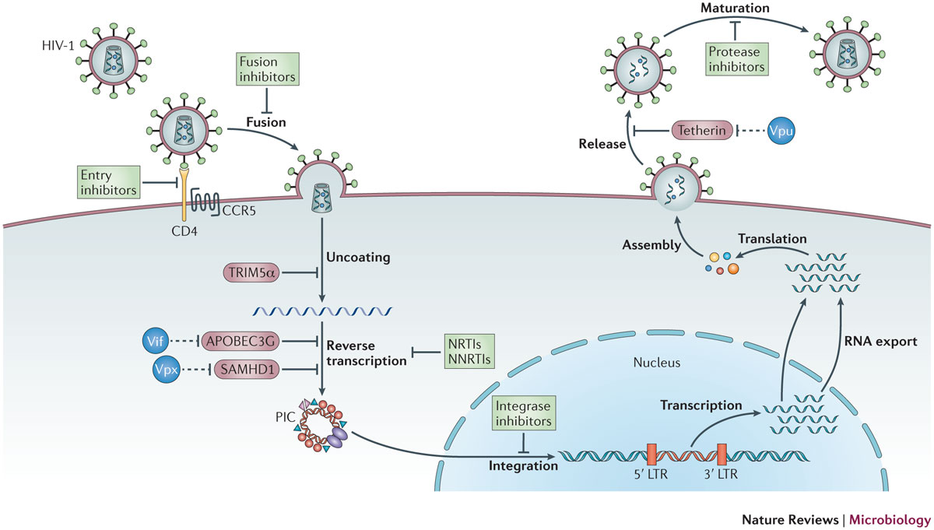
SUMMARY OF HIV INFECTION MECHANISMS
ART MECHANISMS
Barre-Sinoussi et al. Nat Rev Micro, 2013.

Slide 18
FUSION/ENTRY INHIBITORS
MARAVIROC = MVC
Barre-Sinoussi et al. Nat Rev Micro, 2013.

Slide 19
HIV Infection
TROFILE ASSAY = “MIXED” OR “WILD-TYPE”
CXCR4 co-receptor
CCR5 co-receptor
HIV
CD4 receptor
Nucleus
Human CD4+ T cell

Slide 20
FUSION/ENTRY INHIBITORS
ENFUVIRTIDE = FUZEON = T-20
MARAVIROC = MVC
Barre-Sinoussi et al. Nat Rev Micro, 2013.

Slide 21
FUSION/ENTRY INHIBITORS
Fusion Inhibitor = ENFUVIRTIDE
Entry Inhibitor = MARAVIROC
(MUST HAVE CCR5-TROPIC VIRUS)
TROFILE ASSAY

Slide 22
ART MECHANISMS
REVERSE TRANSCRIPTASE INHIBITORS
RT
proviral dna
viral rna
Nucleus
Human CD4+ T cell
https://www.genome.gov/26524120

Slide 23
INTEGRASE INHIBITORS
INTEGRASE
Nucleus
Human CD4+ T cell
https://www.genome.gov/26524120

Slide 24
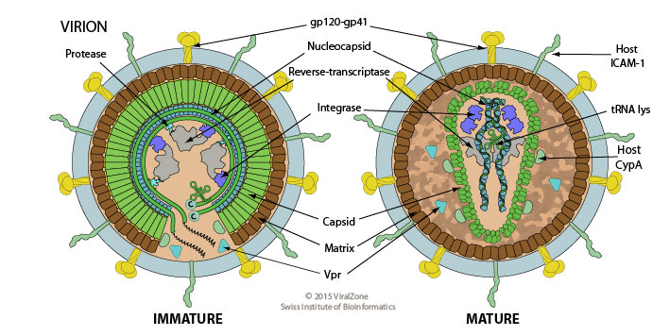
PROTEASE INHIBITORS
PROTEASE

Slide 25
SPECIFIC DRUG NAMES AND THEIR MECHANISMS

Slide 26
REVERSE TRANSCRIPTASE INHIBITORS
RT
proviral dna
viral rna
Nucleus
Human CD4+ T cell
https://www.genome.gov/26524120

Slide 27
REVERSE TRANSCRIPTASE INHIBITORS
NUCLEOSIDE RTIs
(NRTIs) = NUKES
NON-NUCLEOSIDE RTIs
(NNRTIs) = non-NUKES

Slide 28
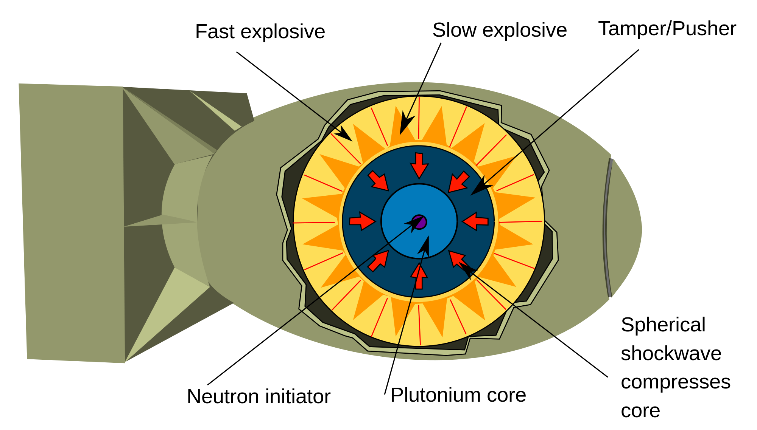
BUILDING A 3-DRUG REGIMEN
INSTI
NNRTI
PI
2 NUKE BACKBONE +
1 DRUG FROM ANOTHER CLASS

Slide 29
REVERSE TRANSCRIPTASE INHIBITORS
NUCLEOSIDE RTIs
(NRTIs) = NUKES
NON-NUCLEOSIDE RTIs
(NNRTIs) = non-NUKES
Tenofovir
Emtricitabine
Abacavir
Lamivudine
Zidovudine
Didanosine
Stavudine

Slide 30
BUILDING A 3-DRUG REGIMEN
2 NUKE BACKBONE

Slide 31
REVERSE TRANSCRIPTASE INHIBITORS
NUCLEOSIDE RTIs
(NRTIs) = NUKES
NON-NUCLEOSIDE RTIs
(NNRTIs) = non-NUKES
Tenofovir
Emtricitabine
=
TRUVADA
Abacavir
Lamivudine
Zidovudine
Didanosine
Stavudine

Slide 32
REVERSE TRANSCRIPTASE INHIBITORS
NUCLEOSIDE RTIs
(NRTIs) = NUKES
NON-NUCLEOSIDE RTIs
(NNRTIs) = non-NUKES
Tenofovir
Emtricitabine
=
TRUVADA
Abacavir
Lamivudine
=
EPZICOM
Zidovudine
Didanosine
Stavudine

Slide 33
REVERSE TRANSCRIPTASE INHIBITORS
NUCLEOSIDE RTIs
(NRTIs) = NUKES
NON-NUCLEOSIDE RTIs
(NNRTIs) = non-NUKES
Tenofovir
Emtricitabine
=
TRUVADA
Abacavir
Lamivudine
=
EPZICOM
Zidovudine
Lamivudine
=
COMBIVIR
Didanosine
Stavudine

Slide 34
REVERSE TRANSCRIPTASE INHIBITORS
NUCLEOSIDE RTIs
(NRTIs) = NUKES
NON-NUCLEOSIDE RTIs
(NNRTIs) = non-NUKES
Tenofovir
Tenofovir
Emtricitabine
=
TRUVADA
Abacavir
Lamivudine
=
EPZICOM
Lamivudine
Zidovudine
Lamivudine
=
COMBIVIR
Didanosine
Stavudine
=
CIMDUO
TEMIXYS

Slide 35
REVERSE TRANSCRIPTASE INHIBITORS
NUCLEOSIDE RTIs
(NRTIs) = NUKES
NON-NUCLEOSIDE RTIs
(NNRTIs) = non-NUKES
Abacavir
Lamivudine
=
EPZICOM
=
TRIZIVIR
Zidovudine
=
COMBIVIR
Zidovudine
Lamivudine

Slide 36
QUIZ QUESTION 1

Slide 37
QUIZ QUESTION 2

Slide 38
REVERSE TRANSCRIPTASE INHIBITORS
NUCLEOSIDE RTIs
(NRTIs) = NUKES
NON-NUCLEOSIDE RTIs
(NNRTIs) = non-NUKES
Efavirenz
Rilpivirine
Etravirine
Nevirapine
Doravirine
-VIR-A-SOMETHING
-VIR in the MIDDLE

Slide 39
REVERSE TRANSCRIPTASE INHIBITORS
NUCLEOSIDE RTIs
(NRTIs) = NUKES
NON-NUCLEOSIDE RTIs
(NNRTIs) = non-NUKES
Tenofovir
Emtricitabine
Efavirenz
Abacavir
Lamivudine
Rilpivirine
Zidovudine
Etravirine
Didanosine
Nevirapine
Stavudine
Doravirine
No Naming Pattern
-VIR-SOMETHING
-VIR in the MIDDLE

Slide 40
BUILDING A 3-DRUG REGIMEN
INSTI
NNRTI
PI
2 NUKE BACKBONE +
1 DRUG FROM ANOTHER CLASS

Slide 41
REVERSE TRANSCRIPTASE INHIBITORS
NUCLEOSIDE RTIs
(NRTIs) = NUKES
NON-NUCLEOSIDE RTIs
(NNRTIs) = non-NUKES
Tenofovir
Emtricitabine
=
TRUVADA
+
Efavirenz
=
Atripla

Slide 42
REVERSE TRANSCRIPTASE INHIBITORS
NUCLEOSIDE RTIs
(NRTIs) = NUKES
NON-NUCLEOSIDE RTIs
(NNRTIs) = non-NUKES
Tenofovir
Emtricitabine
=
TRUVADA
+
Efavirenz
=
Atripla
+
Rilpivirine
=
Complera

Slide 43
REVERSE TRANSCRIPTASE INHIBITORS
NUCLEOSIDE RTIs
(NRTIs) = NUKES
NON-NUCLEOSIDE RTIs
(NNRTIs) = non-NUKES
Tenofovir
Emtricitabine
=
TRUVADA
+
Efavirenz
=
Atripla
Efavirenz
+
Rilpivirine
=
Complera
Tenofovir
Lamivudine
=
CIMDUO
+
Doravirine
=
Delstrigo
Tenofovir
Lamivudine
=
CIMDUO
+
=
Symfi
Efavir
=
Symfi Lo

Slide 44
QUIZ QUESTION 3

Slide 45
PROTEASE INHIBITORS: Boosters
Boosters
Darunavir
Atazanavir
Cobicistat
Lopinavir
Indinavir
Fosamprenavir
Tipranavir
Saquinavir
Nelfinavir
Ritonavir

Slide 46
PROTEASE INHIBITORS
Darunavir
Atazanavir
-NAVIR
Lopinavir
Indinavir
Fosamprenavir
Tipranavir
Saquinavir
Nelfinavir
Ritonavir

Slide 47
PROTEASE INHIBITORS: Boosters
Boosters
Darunavir/r
Ritonavir
Atazanavir/r
Cobicistat
Lopinavir/r
Indinavir/r
Fosamprenavir/r
Tipranavir/r
Saquinavir/r
Nelfinavir/r

Slide 48
PROTEASE INHIBITORS: Boosters
Boosters
Darunavir
Ritonavir
Atazanavir
Cobicistat
Lopinavir
Indinavir
Fosamprenavir
Tipranavir
Saquinavir
Nelfinavir
+
=
Kaletra

Slide 49
PROTEASE INHIBITORS: Boosters
Boosters
Prezista
Darunavir
+
=
Prezcobix
Ritonavir
Atazanavir
Cobicistat
+
Cobicistat

Slide 50
BUILDING A 3-DRUG REGIMEN
INSTI
NNRTI
PI
2 NUKE BACKBONE +
1 DRUG FROM ANOTHER CLASS

Slide 51
INTEGRASE Strand Transfer INHIBITORS “INSTIs”
Raltegravir
-GRAVIR
Elvitegravir
Dolutegravir
Bictegravir

Slide 52
QUIZ QUESTION 4

Slide 53
QUIZ QUESTION 5

Slide 54
QUIZ QUESTION 6

Slide 55
INTEGRASE INHIBITORS
Raltegravir
Elvitegravir
+
+
TRUVADA
=
STRIBILD
Dolutegravir
+
EPZICOM
=
TRIUMEQ
Bictegravir
Cobicistat

Slide 56
COMBO TIME
NRTIs
NNRTIs
IIs
PIs
Booster
TDF
Efavirenz
ELV/cobi
Darunavir
Cobicistat
TAF
Rilpivirine
Dolutegravir
Atazanavir
Abacavir
Lopinavir
Emtricitabine
Ritonavir
Lamivudine
Zidovudine
TRUVADA

Slide 57
COMBO TIME
NRTIs
NNRTIs
IIs
PIs
Booster
Tenofovir
Efavirenz
ELV/cobi
Darunavir
Cobicistat
Abacavir
Rilpivirine
Dolutegravir
Atazanavir
Emtricitabine
Lopinavir
Lamivudine
Ritonavir
Zidovudine
ATRIPLA

Slide 58
COMBO TIME
NRTIs
NNRTIs
IIs
PIs
Booster
Tenofovir
Efavirenz
ELV/cobi
Darunavir
Cobicistat
Abacavir
Rilpivirine
Dolutegravir
Atazanavir
Emtricitabine
Lopinavir
Lamivudine
Ritonavir
Zidovudine
COMPLERA

Slide 59
COMBO TIME
NRTIs
NNRTIs
IIs
PIs
Booster
Tenofovir
Efavirenz
ELV/cobi
Darunavir
Cobicistat
Abacavir
Rilpivirine
Dolutegravir
Atazanavir
Bictegravir
Emtricitabine
Lopinavir
Lamivudine
Ritonavir
Zidovudine
STRIBILD

Slide 60
COMBO TIME
NRTIs
NNRTIs
IIs
PIs
Booster
Tenofovir
Efavirenz
ELV/cobi
Darunavir
Cobicistat
Abacavir
Rilpivirine
Dolutegravir
Atazanavir
Bictegravir
Emtricitabine
Lopinavir
Lamivudine
Ritonavir
Zidovudine
TRIUMEQ

Slide 61
3 LETTER ABBREVIATIONS:
NRTIs
ZIDOVUDINE
AZT
LAMIVUDINE
3TC
EMTRICITABINE
FTC
TENOFOVIR
TDF
ABACAVIR
ABC
DIDANOSINE
ddI
STAVUDINE
d4T

Slide 62
3 LETTER ABBREVIATIONS:
NRTIs and NNRTIs
ZIDOVUDINE
AZT
EFAVIRENZ
EFV
LAMIVUDINE
3TC
RILPIVIRINE
RPV
EMTRICITABINE
FTC
ETRAVIRINE
ETV
TENOFOVIR
TDF
NEVIRAPINE
NVP
ABACAVIR
ABC
DORAVIRINE
DOR
DIDANOSINE
ddI
STAVUDINE
d4T

Slide 63
3-LETTER ABBREVIATIONS: PIs AND IIs
PROTEASE INHIBITORS
INTEGRASE INHIBITORS
DARUNAVIR
DRV
RALTEGRAVIR
RAL
ATAZANAVIR
ATV
ELVITEGRAVIR
EVG
DOLUTEGRAVIR
DTG
BICTEGRAVIR
BIC
BRAND NAME
TIVICAY

Slide 64
QUIZ QUESTION 7

Slide 65
Let’s talk about TAF
TDF = Tenofovir disoproxil fumarate
TAF = Tenofovir alafenamide

Slide 66
TAF COMBOS
Tenofovir
Emtricitabine
=
TRUVADA
TRU
TAF
Emtricitabine
=
DESCOVY
TRUF

Slide 67
TAF COMBOS
TRUVADA (TRU)
+
Rilpivirine
=
COMPLERA
DESCOVY (TRUF)
+
Rilpivirine
=
ODEFSEY
TRUVADA (TRU)
+
ELV/cobi
=
STRIBILD
DESCOVY (TRUF)
+
ELV/cobi
=
GENVOYA
DESCOVY (TRUF)
+
BICTEGRAVIR
=
BIKTARVY
DESCOVY (TRUF)
+
DARUNAVIR/COBI
=
SYMTUZA

Slide 68
TAF COMBO TIME
NRTIs
NNRTIs
IIs
PIs
Booster
TDF
Efavirenz
ELV/cobi
Darunavir
Cobicistat
TAF
Rilpivirine
Dolutegravir
Atazanavir
Abacavir
Bictegravir
Lopinavir
Emtricitabine
Ritonavir
Lamivudine
Zidovudine
DESCOVY

Slide 69
TAF COMBO TIME
NRTIs
NNRTIs
IIs
PIs
Booster
TDF
Efavirenz
ELV/cobi
Darunavir
Cobicistat
Rilpivirine
Dolutegravir
Atazanavir
Abacavir
Bictegravir
Lopinavir
Ritonavir
Lamivudine
Zidovudine
TAF
Emtricitabine
BIKTARVY
DESCOVY

Slide 70
TAF COMBO TIME
NRTIs
NNRTIs
IIs
PIs
Booster
Efavirenz
Cobicistat
TDF
ELV/cobi
Darunavir
Cobicistat
Darunavir
Rilpivirine
Dolutegravir
Atazanavir
Abacavir
Bictegravir
Lopinavir
Ritonavir
Lamivudine
Zidovudine
TAF
Emtricitabine
DESCOVY
PREZCOBIX
SYMTUZA

Slide 71
QUIZ QUESTION 8

Slide 72
QUIZ QUESTION 9

Slide 73
QUIZ QUESTION 10

Slide 74
3- DRUG THERAPY:
SINGLE TABLET REGIMENS
NRTIs
NNRTIs
IIs
PIs
TRUVADA
+
Efavirenz
=
Atripla
ELV/cobi
=
Stribild
+
Rilpivirine
=
Complera
TDF/3TC
+
Doravirine
=
Delstrigo
+
Efavirenz
=
Symfi (Lo)
DESCOVY
+
Rilpivirine
=
Odefsey
ELV/cobi
=
Genvoya
DRV/cobi
=
Symtuza
BIC
=
Biktarvy
EPZICOM
+
Dolutegravir
=
Triumeq

Slide 75
2- DRUG THERAPY:
THE NEW WORLD ORDER
NRTIs
NNRTIs
IIs
PIs
Rilpivirine
+
Dolutegravir
=
JULUCA
Lamivudine
+
Dolutegravir
=
DOVATO

Slide 76
WHAT TO START ?
NEED TO EAT
DOESN’T MATTER
Genvoya
STRIBILD
BIKTARVY
Odefsey
Complera
DESCOVY
DTG
TRU
DTG
TRIUMEQ

Slide 77
WHAT TO START ?
NEED TO EAT
DOESN’T MATTER
Genvoya
STRIBILD
BIKTARVY
Odefsey
Complera
DESCOVY
DTG
TRU
DTG
Certain inhaled/nasal steroids
Certain HCV regimens
Lower dosing of statins
TRIUMEQ

Slide 78
WHAT TO START ?
NEED TO EAT
DOESN’T MATTER
Genvoya
STRIBILD
BIKTARVY
Odefsey
Complera
DESCOVY
DTG
TRU
DTG
PPIs, Seizure meds, Rifampin
TRIUMEQ

Slide 79
WHAT TO START ?
NEED TO EAT
DOESN’T MATTER
Genvoya
STRIBILD
BIKTARVY
Odefsey
Complera
DESCOVY
DTG
TRU
DTG
TRIUMEQ
Twice daily dosing of
DTG with rifampin; lower dosing of
Metformin while on DTG

Slide 80
WHAT TO START ?
NEED TO EAT
DOESN’T MATTER
Genvoya
STRIBILD
BIKTARVY
DESCOVY
DTG
TRU
DTG
TRIUMEQ
Mg++, Ca++, Fe++

Slide 81
EXERCISE
NNRTI in ATRIPLA
II in STRIBILD
NNRTI in ODEFSEY
EFAVIRENZ
ELVITEGRAVIR
RILPIVIRINE
NNRTI: COMPLERA
TIVICAY
NEWEST
NNRTI
RILPIVIRINE
DTG
DORAVIRINE
FTC
WHAT’S IN PREZCOBIX?
NRTIs in DESCOVY
EMTRICITABINE
DRV/COBI
TAF/FTC
d4T
3TC
II in BIKTARVY
RILPIV/DTG
LAMIVUDINE
BICTEGRAVIR

Slide 82
MORE FUN
TAF/FTC
EVG/C/TAF/FTC
3TC/DTG
ABC/3TC/DTG
DRV/COBI
DTG/RPV
TAF/FTC/RPV
TAF/FTC/DRV/COBI
II IN TRIUMEQ
PI IN PREZCOBIX
II IN GENVOYA

Slide 83
3- DRUG THERAPY:
SINGLE TABLET REGIMENS
NRTIs
NNRTIs
IIs
PIs
TRUVADA
+
Efavirenz
=
Atripla
ELV/cobi
=
Stribild
+
Rilpivirine
=
Complera
TDF/3TC
+
Doravirine
=
Delstrigo
+
Efavirenz
=
Symfi (Lo)
DESCOVY
+
Rilpivirine
=
Odefsey
ELV/cobi
=
Genvoya
DRV/cobi
=
Symtuza
BIC
=
Biktarvy
EPZICOM
+
Dolutegravir
=
Triumeq

Slide 85
MUTATIONS
M184V
K103N
EMTRICITABINE
EFAVIRENZ
LAMIVUDINE
NEVIRAPINE
TENOFOVIR

